Slide 1




Thynk Unlimited
Liturgy of the Word
Mercredi 27 Mai 2025

Slide 2
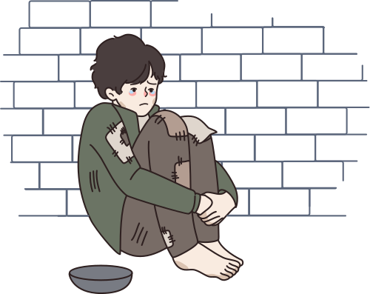
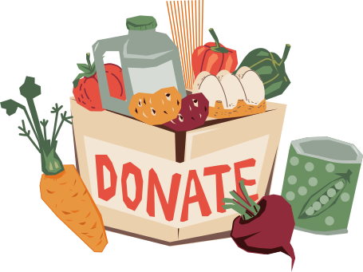


DAILY THEME
We are Pilgrims of Hope by responding to the poverties in the world

Slide 3

CALL TO PRAYER
We are pilgrims of hope when we respond to the different kinds of poverty in our world. As we celebrate the gift of Catholic Education in this Jubilee Year of Hope, we reflect on our mission to be pilgrims of hope who respond to the poverty in our world. Our Catholic faith calls us to be friends of people experiencing poverty either because of a lack of sufficient housing, food, clothing or because they are marginalized, suffering from indifference or exclusion. We are called to live in solidarity with one another as we are all the children of God
During this Jubilee year, we are reminded that God gives special priority and attention to the most vulnerable people in society. We bring hope when we put the needs of the poor first and try to create a fairer, more just world.
As pilgrims of hope, we give thanks to God for the gift of Catholic Education which moves us to justice and peace!

Slide 4
OPENING PRAYER
God of love,
Open our hearts on our pilgrim journey so that we may recognize our neighbours in need.
Continue to bless us with compassion and kindness so that we may respond with an open heart.
May our hope in you continue to light our path.
We make this prayer in the name of Jesus, our light and hope.
Amen.
03

Slide 5
DAILY READING
The Lord be with you.​
R. And with your Spirit.​
​
A reading from the holy gospel according to Matthew (25:35-40) R. Glory to you O Lord
“… for I was hungry and you gave me food, I was thirsty and you gave me something to drink, I was a stranger and you welcomed me, I was naked and you gave me clothing, I was sick and you took care of me, I was in prison and you visited me.” Then the righteous will answer him, “Lord, when was it that we saw you hungry and gave you food, or thirsty and gave you something to drink? And when was it that we saw you a stranger and welcomed you, or naked and gave you clothing? And when was it that we saw you sick or in prison and visited you?” And the king will answer them, “Truly I tell you, just as you did it to one of the least of these who are members of my family, you did it to me.”
The Gospel of the Lord R. Praise to you Lord Jesus Christ

Slide 6
REFLECTION
Stop, look and listen to the community and families around you about what is needed to meet their experiences of poverty, then work together in solidarity with one another and Jesus to meet the brokenness head on! Put heads and hearts together to discover new ways to create unity, oneness and support for one another in our daily relationships! In what ways can you and I reach out to those who are excluded, marginalized and in need? Be creative!
In Jesus the Christ there are no walls, only the shortcomings of our imaginations.

Slide 7

REFLECTION
What are people around me hungering for? Food? Love? Companionship?
What are people around me thirsting for? Drink? Justice? Peace?
How are people around me naked? No clothes? Vulnerable to injustice? Stripped of the dignity of being a child of God?
What sickness thrives in those near me? Disease? Dis-ease? Physical, psychological, emotional, or spiritual injury?
Look around. What does it mean for those around me to be homeless? No house? No community? No country?
How are those around me imprisoned? In Jail? Hostage to addictions? Bound up in fear and anxiety?
Where is death touching the children of God around me? War? Physical passing? Despair with no hope or light? Blindness and deafness?

Slide 8




CALL TO ACTION
Stop, look and listen to the community and families around you about what is needed to meet their experiences of poverty, then work together in solidarity with one another and Jesus to meet the brokenness head on! Put heads and hearts together to discover new ways to create unity, oneness and support for one another in our daily relationships! In what ways can you and I reach out to those who are excluded, marginalized and in need? Be creative!
In Jesus the Christ there are no walls, only the shortcomings of our imaginations.

Slide 9
CALL TO ACTION
Some starting points for personal solidarity practices:
  Volunteer at a soup kitchen or food bank, showing love through action.
  Organize a donation drive for those in need in your community like gathering and passing out blankets to the homeless.
  Participate in interfaith dialogue to demonstrate an understanding among different beliefs.
  Pray for those who are suffering and take action to support social justice initiatives like those through Development and Peace.
  Make a new friend.

Slide 10
CLOSING PRAYER
God of love and mercy,
God of empathy and compassion,
We strive to love others as we are loved by you.
Give us hearts of compassion,
that our pilgrim journey of hope,
finds us stopping to be there for others along the way.
Strengthen us in becoming Your Hope in the face of all poverty faced by people.
May our hope in you continue to guide us and light our way.
We make this prayer in the name of Jesus, our light and hope.
Amen.
03

Slide 11





THANK YOU
We are grateful to the
Ontario Catholic School Trustees Association
for allowing us to adapt their materials
for use in our Saskatchewan schools
https://www.ocsta.on.ca/project/cet-2024-25-pilgrims-of-hope/

