Slide 1




Thynk Unlimited
La prière de la journée
mercredi, le 27 mai 2025

Slide 2
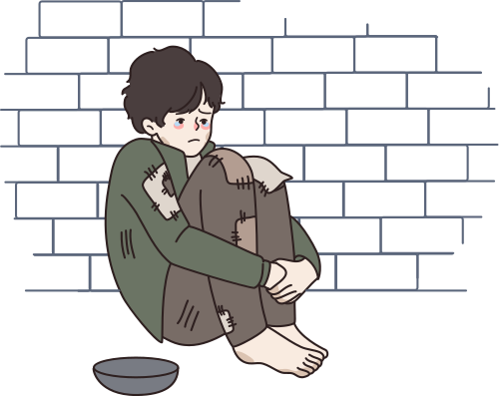
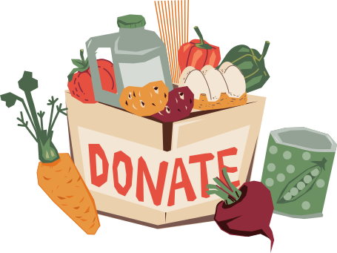


DAILY THEME
We are Pilgrims of Hope by responding to the poverties in the world

Slide 3

APPEL À LA PRIÈRE
Nous sommes des pèlerins d'espérance lorsque nous répondons aux différentes formes de pauvreté dans notre monde.
En célébrant le don de l'éducation catholique en cette Année jubilaire de l'espérance, nous réfléchissons à notre mission: d’être des pèlerins d'espérance pour répondre à la pauvreté dans notre monde. Notre foi catholique nous appelle à aider les personnes en situation de pauvreté, que ce soit par manque de logement, de nourriture ou de vêtements, ou parce qu'elles sont marginalisées, victimes d'indifférence ou d'exclusion. Nous sommes appelés à vivre en solidarité les uns avec les autres, car nous sommes tous des enfants de Dieu.
En cette année jubilaire, nous nous rappelons que Dieu accorde une priorité et une attention particulière aux personnes les plus vulnérables de la société. Nous apportons de l'espoir lorsque nous accordons la priorité aux besoins des pauvres et que nous essayons de créer un monde plus juste et équitable.
En tant que pèlerins d'espérance, nous rendons grâce à Dieu pour le don de l'éducation catholique qui nous pousse vers la justice et la paix!

Slide 4
LA PRIÈRE DE LA JOURNÉE
Dieu d'amour,
Ouvrez nos cœurs sur notre chemin de pèlerinage et aidez-nous à reconnaître nos voisins qui sont dans le besoin.
Continuez de nous bénir avec compassion et bonté et aidez-nous à répondre avec un cœur ouvert.
Que notre espérance en vous continue d'éclairer notre chemin.
Nous demandons cette prière au nom de Jésus, notre lumière et notre espérance.
Amen.
03

Slide 5
DAILY READING
The Lord be with you.​ R. And with your Spirit.​
A reading from the holy gospel according to Matthew (25:35-40) R. Glory to you O Lord
“… for I was hungry and you gave me food, I was thirsty and you gave me something to drink, I was a stranger and you welcomed me, I was naked and you gave me clothing, I was sick and you took care of me, I was in prison and you visited me.” Then the righteous will answer him, “Lord, when was it that we saw you hungry and gave you food, or thirsty and gave you something to drink? And when was it that we saw you a stranger and welcomed you, or naked and gave you clothing? And when was it that we saw you sick or in prison and visited you?” And the king will answer them, “Truly I tell you, just as you did it to one of the least of these who are members of my family, you did it to me.”
The Gospel of the Lord
R. Praise to you Lord Jesus Christ
03

Slide 6
REFLECTION
Stop, look and listen to the community and families around you about what is needed to meet their experiences of poverty, then work together in solidarity with one another and Jesus to meet the brokenness head on! Put heads and hearts together to discover new ways to create unity, oneness and support for one another in our daily relationships! In what ways can you and I reach out to those who are excluded, marginalized and in need? Be creative!
In Jesus the Christ there are no walls, only the shortcomings of our imaginations.

Slide 7

REFLECTION
What are people around me hungering for? Food? Love? Companionship?
What are people around me thirsting for? Drink? Justice? Peace?
How are people around me naked? No clothes? Vulnerable to injustice? Stripped of the dignity of being a child of God?
What sickness thrives in those near me? Disease? Dis-ease? Physical, psychological, emotional, or spiritual injury?
Look around. What does it mean for those around me to be homeless? No house? No community? No country?
How are those around me imprisoned? In Jail? Hostage to addictions? Bound up in fear and anxiety?
Where is death touching the children of God around me? War? Physical passing? Despair with no hope or light? Blindness and deafness?

Slide 8




CALL TO ACTION
Stop, look and listen to the community and families around you about what is needed to meet their experiences of poverty, then work together in solidarity with one another and Jesus to meet the brokenness head on! Put heads and hearts together to discover new ways to create unity, oneness and support for one another in our daily relationships! In what ways can you and I reach out to those who are excluded, marginalized and in need? Be creative!
In Jesus the Christ there are no walls, only the shortcomings of our imaginations.

Slide 9
CALL TO ACTION
Some starting points for personal solidarity practices:
  Volunteer at a soup kitchen or food bank, showing love through action.
  Organize a donation drive for those in need in your community like gathering and passing out blankets to the homeless.
  Participate in interfaith dialogue to demonstrate an understanding among different beliefs.
  Pray for those who are suffering and take action to support social justice initiatives like those through Development and Peace.
  Make a new friend.

Slide 10
CLOSING PRAYER
God of love and mercy,
God of empathy and compassion,
We strive to love others as we are loved by you.
Give us hearts of compassion,
that our pilgrim journey of hope,
finds us stopping to be there for others along the way.
Strengthen us in becoming Your Hope in the face of all poverty faced by people.
May our hope in you continue to guide us and light our way.
We make this prayer in the name of Jesus, our light and hope.
Amen.
03

Slide 11





THANK YOU
We are grateful to the
Ontario Catholic School Trustees Association
for allowing us to adapt their materials
for use in our Saskatchewan schools
https://www.ocsta.on.ca/project/cet-2024-25-pilgrims-of-hope/

