Slide 1




Thynk Unlimited
La prière de la journée
lundi, le 25 mai 2025

Slide 2

INTRODUCTION TO THE WEEK
Each year, Catholic Schools in Saskatchewan engage in a week-long celebration to remember, promote, and share the unique identity and distinctive contributions of Catholic Education during Catholic Education Week.
This year’s celebration entitled, “Catholic Education: Pilgrims of
Hope,” is inspired by the theme for this Jubilee Year declared by Pope Francis. The passage that guides our theme is, “We must fan the flame of hope that has been given to us,” which is a quote from Pope Francis in the context of the Jubilee Year of Hope 2025.

Slide 3
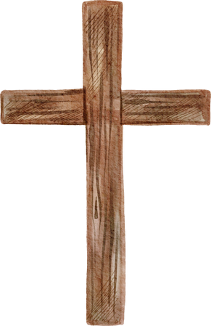
INTRODUCTION TO THE WEEK
The theme reminds us that…
We are to be pilgrims who fan the flame of hope and help everyone to gain new strength and certainty by looking to the future with an open spirit, a trusting heart, and far-sighted vision.
We are asked to focus prayerfully on the bonds that unite our whole human family, to
reflect on the rampant poverty in our world, and to think about the plight of the many
refugees forced to leave their homes.
We are summoned to contemplate the beauty of creation and be stewards who care for
our common home.
We are encouraged to keep moving ahead in faith, in joy, and in hope, as part of a
pilgrim people.
Catholic Education helps us to do all this and more! And so, we celebrate the gift of Catholic Education always, but in a special way this week.

Slide 4
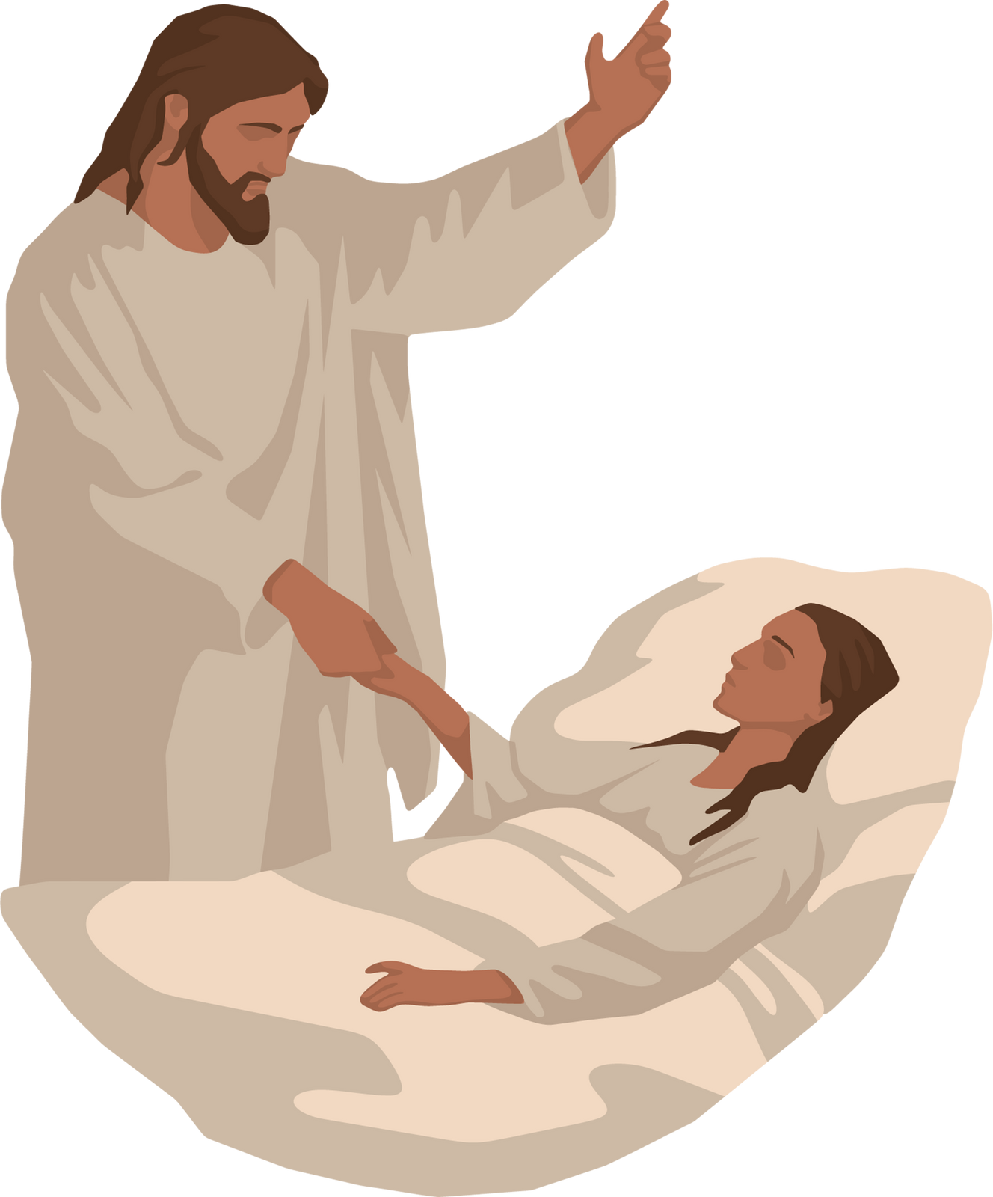
DAILY THEME
We are Pilgrims of Hope when we Honour
Human Dignity

Slide 5

APPEL À LA PRIÈRE / THÈME POUR LA JOURNÉE
Alors que nous célébrons le don de l'éducation catholique en cette année jubilaire, nous réfléchissons à notre mission: être des pèlerins d'espérance qui honorent la dignité humaine. Notre foi catholique nous enseigne que chaque personne est créée à l'image de Dieu et possède une dignité spéciale. Nous honorons la dignité humaine lorsque nous voyons l'image de Dieu en chaque personne et lorsque nous respectons chaque personne comme nos frères et nos sœurs. En respectant la dignité humaine, nous devenons des signes d'espoir dans nos écoles, nos familles et nos communautés.
En tant que pèlerins d'espérance, nous rendons grâce à Dieu pour l'éducation catholique alors que nous prions ensemble…
Au nom du Père, du Fils et du Saint-Esprit. Amen.
03

Slide 6
LA PRIÈRE DE LA JOURNÉE
Dieu bon et miséricordieux,
Soyez avec nous, pèlerins d'espoir et bâtisseurs de paix, sur notre chemin.
Aidez-nous à semer des graines de foi, d'espérance et d'amour tout au long du chemin.
Soyez avec nous et partagez le chemin avec nous.
Bénissez notre chemin et soyez notre guide.
Aidez-nous à aimer notre prochain comme vous nous aimez.
Aidez-nous à respecter la dignité humaine en accueillant chaque personne dans nos communautés avec un cœur ouvert, rempli d'amour et de gentillesse.
Nous vous le demandons au nom de Jésus. Amen.

Slide 7
DAILY READING
Scripture: 1 John 3:1-3 (International Children’s Bible)
A reading from the First Letter of John.
The Father has loved us so much! He loved us so much that we are called children of God. And we really are his children. But the people in the world do not understand that we are God’s children, because they have not known him. Dear friends, now we are children of God. We have not yet been shown what we will be in the future. But we know that when Christ comes again, we will be like him. We will see him as he really is. Christ is pure. And every person who has this hope in Christ keeps himself pure like Christ.
The Word of the Lord.
Thanks be to God.
06
04
03

Slide 8
REFLECTION
The scripture passage reminds us of our true identity as children of God. It speaks to our worth, purpose, and the incredible love that God has lavished upon us. Understanding and embracing this truth can transform our lives, giving us confidence, security, and a sense of belonging that surpasses anything the world can offer.
The apostle John emphasizes the incredible love that God has poured out on us, calling us His children.
Being a child of God sets us apart from the world’s system of values and priorities.
As children of God, we have a hope in Christ’s return and the promise of being transformed into His likeness.
This hope motivates us to live lives that reflect His purity and holiness, and to pursue righteousness and strive for personal growth.
Our identity as children of God compels us to recognize that each and every person is a child of God and therefore has inherent dignity that we must honour.

Slide 9
REFLECTION
In essence, today’s scripture passage encourages us to live in light of our identity as God's children, to anticipate the future glory that awaits us, and to strive for a life of purity and holiness, reflecting the image of Christ.

Slide 10




CALL TO ACTION
One way we honour human dignity – our own and that of others, is to LOVE. The Bible tells us that it is by our actions that we show our love. Think of at least one loving thing – a kind act – you can do today and each day of this Catholic Education Week for the members of your family and for your friends. Then, make sure you remember to do it!

Slide 11
CLOSING PRAYER
Dear Lord,
We ask for your blessing as we journey as Pilgrims of Hope
who honour human dignity through our kind and loving actions.
Guide our minds and fill our hearts with hope and love.
Nurture our relationships and help us to see your divine image in each other
and give us courage to work for justice.
May the flame of hope be enkindled in our hearts by the Holy Spirit
and reawaken in us the blessed hope for the coming of your Kingdom.
We ask all this in Jesus' name.
Amen.
03

Slide 12





THANK YOU
We are grateful to the
Ontario Catholic School Trustees Association
for allowing us to adapt their materials
for use in our Saskatchewan schools
https://www.ocsta.on.ca/project/cet-2024-25-pilgrims-of-hope/

