Slide 2
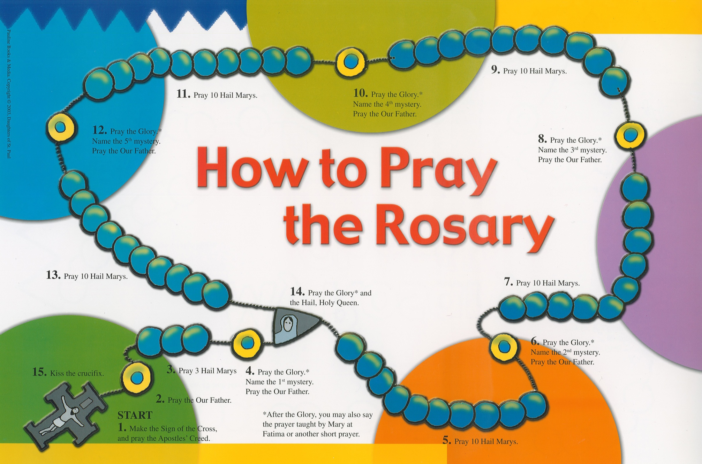

Slide 3
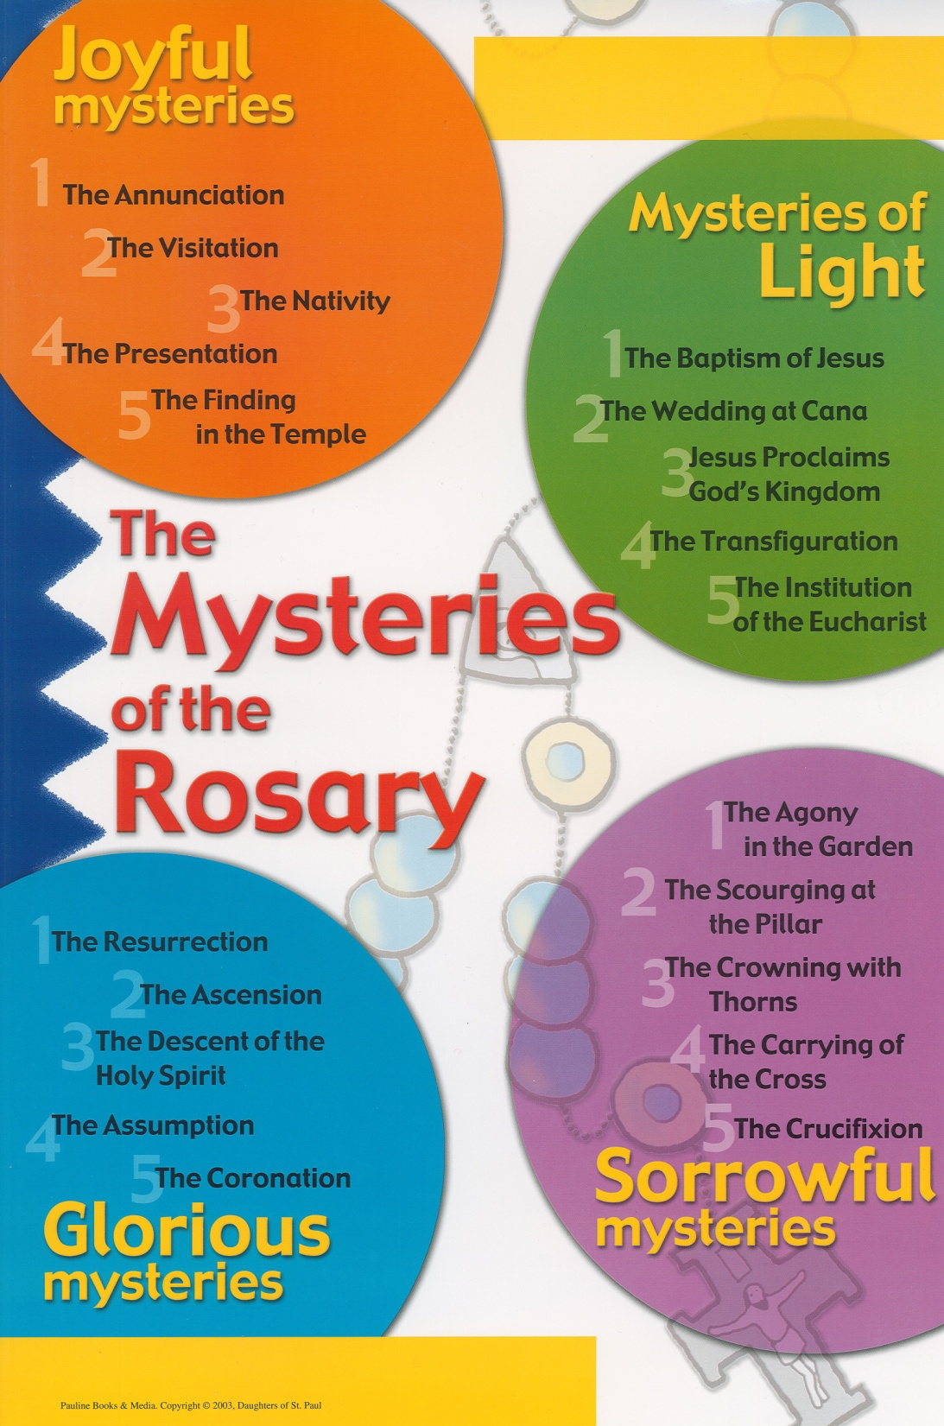

Slide 4
The Apostle's Creed
(pray while holding the crucifix on the Rosary)
In the name of the Father and of the Son and of the Holy Spirit. Amen.
I believe in God, the Father Almighty, Creator of Heaven and earth, and in Jesus Christ, his only Son, Our Lord, who was conceived by the Holy Spirit, born of the Virgin Mary, suffered under Pontius Pilate, was crucified, died, and was buried; he descended into hell; on the third day He rose again from the dead; he ascended into Heaven, and is seated at the right hand of God the Father Almighty; from there he will come to judge the living and the dead.
I believe in the Holy Spirit, the holy catholic Church, the communion of saints, the forgiveness of sins, the resurrection of the body, and the life everlasting. Amen.

Slide 5
Our Father
(pray while holding the first bead)
Our Father, Who are in heaven, hallowed be Your name; Your kingdom come; Your will be done on earth as it is in heaven. Give us this day our daily bread; and forgive us our trespasses as we forgive those who trespass against us; and lead us not into temptation, but deliver us from evil. Amen.

Slide 6
Hail Mary
(one Hail Mary for each of the next three beads)
Hail Mary, full of grace. The Lord is with you. Blessed are you among women, and blessed is the fruit of your womb, Jesus. Holy Mary, Mother of God, pray for us sinners, now and at the hour of our death, Amen. (3 times)

Slide 7
Glory Be
(pray while holding the large bead)
Glory be to the Father, and to the Son, and to the Holy Spirit, as it was in the beginning, is now, and ever shall be, world without end. Amen.

Slide 8


Slide 9
Our Father
(pray while holding the large bead)
Our Father, Who are in heaven, hallowed be Your name; Your kingdom come; Your will be done on earth as it is in heaven. Give us this day our daily bread; and forgive us our trespasses as we forgive those who trespass against us; and lead us not into temptation, but deliver us from evil. Amen.

Slide 10
Hail Mary
(one Hail Mary for each of the next ten beads)
Hail Mary, full of grace. The Lord is with you. Blessed are you among women, and blessed is the fruit of your womb, Jesus. Holy Mary, Mother of God, pray for us sinners, now and at the hour of our death, Amen. (3 times)

Slide 11
Glory Be
(pray while holding the large bead)
Glory be to the Father, and to the Son, and to the Holy Spirit, as it was in the beginning, is now, and ever shall be, world without end. Amen.

Slide 12
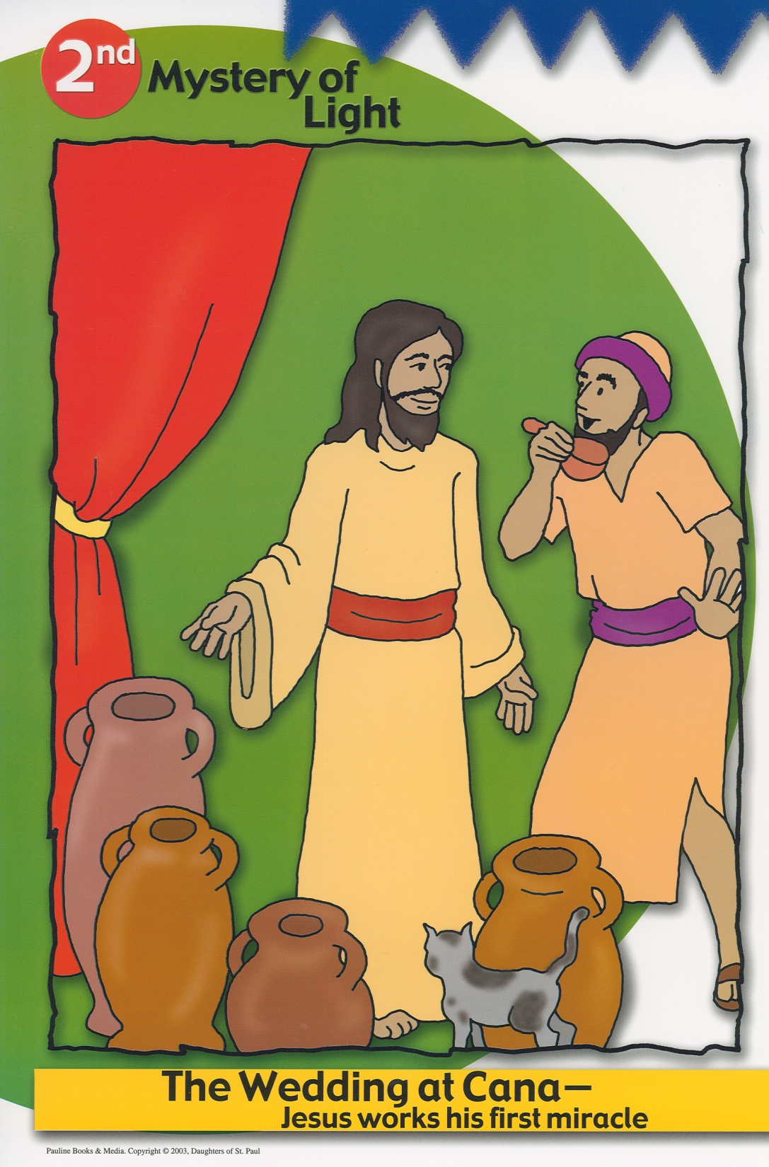

Slide 13
Our Father
(pray while holding the large bead)
Our Father, Who are in heaven, hallowed be Your name; Your kingdom come; Your will be done on earth as it is in heaven. Give us this day our daily bread; and forgive us our trespasses as we forgive those who trespass against us; and lead us not into temptation, but deliver us from evil. Amen.

Slide 14
Hail Mary
(one Hail Mary for each of the next ten beads)
Hail Mary, full of grace. The Lord is with you. Blessed are you among women, and blessed is the fruit of your womb, Jesus. Holy Mary, Mother of God, pray for us sinners, now and at the hour of our death, Amen. (3 times)

Slide 15
Glory Be
(pray while holding the large bead)
Glory be to the Father, and to the Son, and to the Holy Spirit, as it was in the beginning, is now, and ever shall be, world without end. Amen.

Slide 16
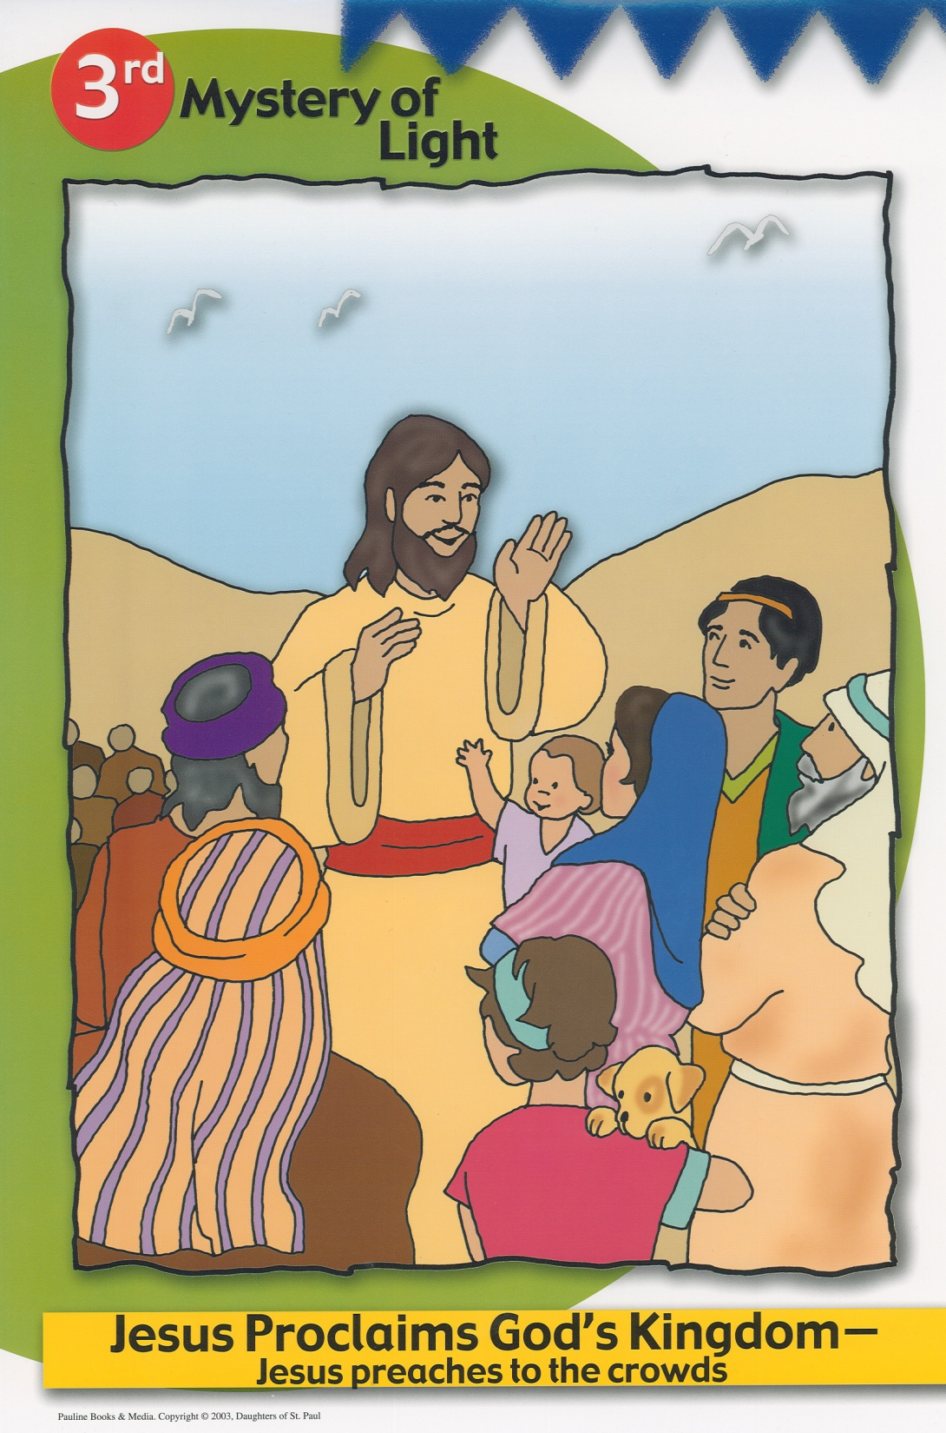

Slide 17
Our Father
(pray while holding the large bead)
Our Father, Who are in heaven, hallowed be Your name; Your kingdom come; Your will be done on earth as it is in heaven. Give us this day our daily bread; and forgive us our trespasses as we forgive those who trespass against us; and lead us not into temptation, but deliver us from evil. Amen.

Slide 18
Hail Mary
(one Hail Mary for each of the next ten beads)
Hail Mary, full of grace. The Lord is with you. Blessed are you among women, and blessed is the fruit of your womb, Jesus. Holy Mary, Mother of God, pray for us sinners, now and at the hour of our death, Amen. (3 times)

Slide 19
Glory Be
(pray while holding the large bead)
Glory be to the Father, and to the Son, and to the Holy Spirit, as it was in the beginning, is now, and ever shall be, world without end. Amen.

Slide 20
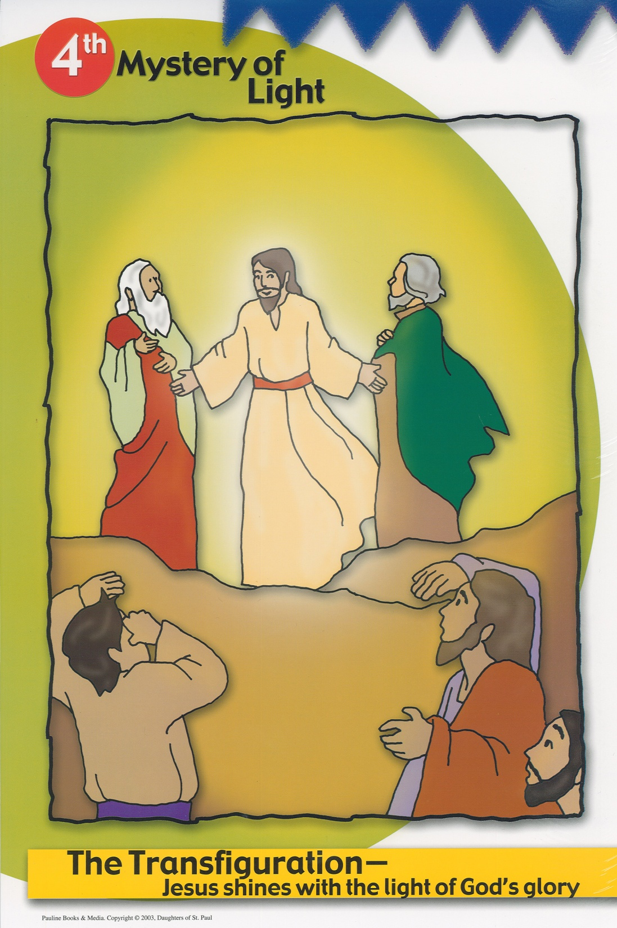

Slide 21
Our Father
(pray while holding the large bead)
Our Father, Who are in heaven, hallowed be Your name; Your kingdom come; Your will be done on earth as it is in heaven. Give us this day our daily bread; and forgive us our trespasses as we forgive those who trespass against us; and lead us not into temptation, but deliver us from evil. Amen.

Slide 22
Hail Mary
(one Hail Mary for each of the next ten beads)
Hail Mary, full of grace. The Lord is with you. Blessed are you among women, and blessed is the fruit of your womb, Jesus. Holy Mary, Mother of God, pray for us sinners, now and at the hour of our death, Amen. (3 times)

Slide 23
Glory Be
(pray while holding the large bead)
Glory be to the Father, and to the Son, and to the Holy Spirit, as it was in the beginning, is now, and ever shall be, world without end. Amen.

Slide 24
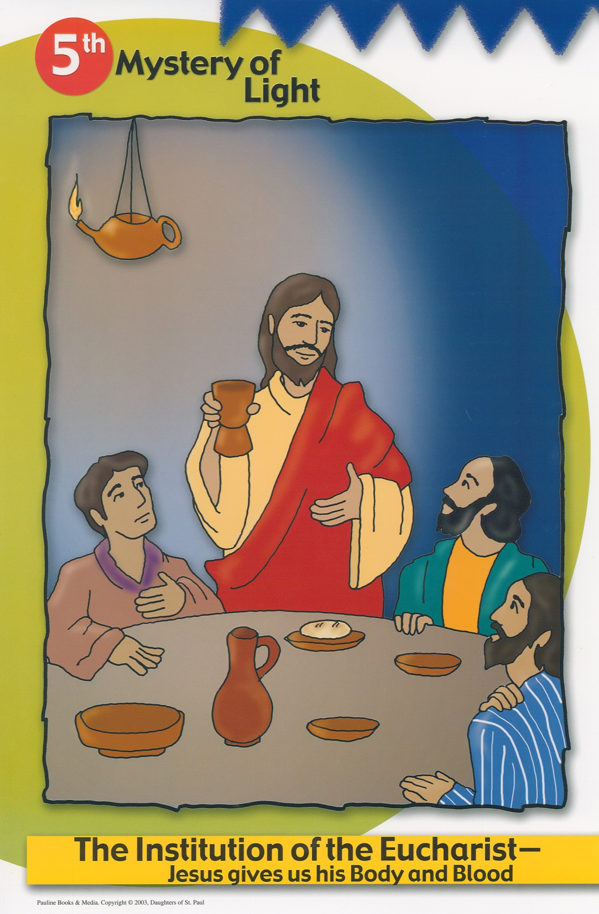

Slide 25
Our Father
(pray while holding the large bead)
Our Father, Who are in heaven, hallowed be Your name; Your kingdom come; Your will be done on earth as it is in heaven. Give us this day our daily bread; and forgive us our trespasses as we forgive those who trespass against us; and lead us not into temptation, but deliver us from evil. Amen.

Slide 26
Hail Mary
(one Hail Mary for each of the next ten beads)
Hail Mary, full of grace. The Lord is with you. Blessed are you among women, and blessed is the fruit of your womb, Jesus. Holy Mary, Mother of God, pray for us sinners, now and at the hour of our death, Amen. (3 times)

Slide 27
Glory Be
(pray while holding the large bead)
Glory be to the Father, and to the Son, and to the Holy Spirit, as it was in the beginning, is now, and ever shall be, world without end. Amen.

Slide 28
Hail, Holy Queen
All: Hail, holy Queen, Mother of mercy, our life, our sweetness and our hope. To you do we cry, poor banished children of Eve: to you do we send up our sighs, mourning and weeping in this valley of tears. Turn then, most gracious Advocate, your eyes of mercy toward us, and after this our exile, show unto us the blessed fruit of your womb, Jesus. O clement, O loving, O sweet Virgin Mary!
Leader: Pray for us O Holy Mother of God,
All: That we may be worthy of the promises of Christ. In the name of the Father and of the Son and of the Holy Spirit. Amen.

